Slide 1
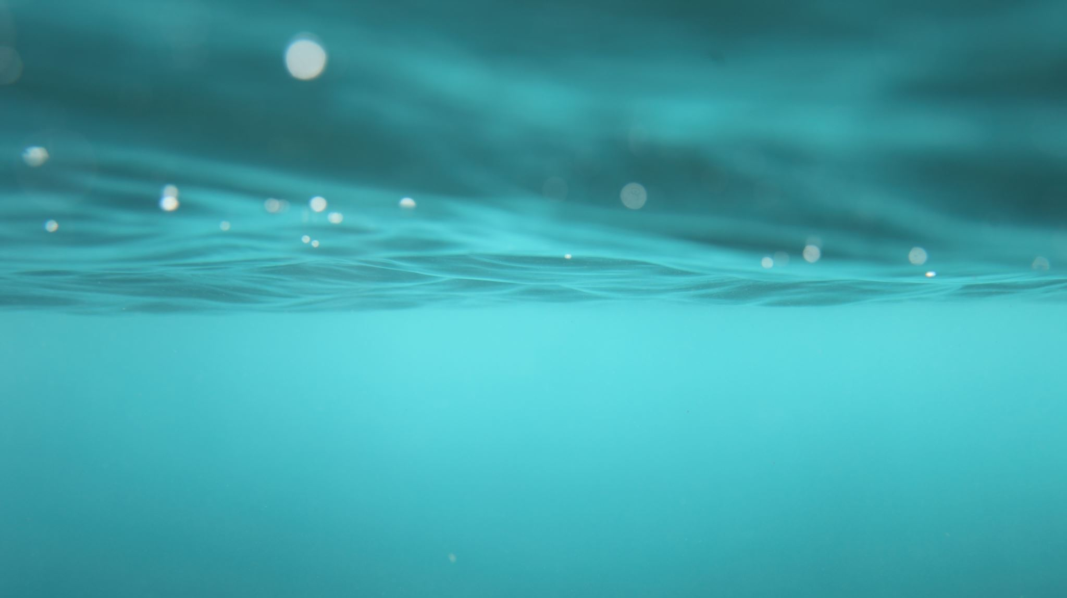
Comp 20 Web Programming
PHP

Slide 2
PHP Script Fits in with HTML
PHP script code is embedded within the web page
.php is the default extension that most Web servers use to recognize PHP scripts
Server
HTML Markup
PHP Script
HTML/JS served to browser

Slide 3
Echo – displays to the page
<html>
<head><title>My first PHP Page</title></head>
<body>
<!– The following is a php “code island” -->
<?php
echo “<p>Hello World!</p>";
?>
</body>
</html>

Slide 4





Three “views”
.php file
Original code – i.e, .php file
What it looks like in the browser
The browser “source”
Bottom line: only someone with access to the server can see or modify php code.
PHP code
HTML code
PHP engine
Discard
“HTML” Bucket

Slide 5
PHP Basics & Variables
Variables are loosely typed – no separate variable declaration
“.” for concatenation
Single or double quotes for strings
No concatenation needed with double quote
$y = 10;
echo “The answer is $y”;
echo ‘The answer is’ . $y;
Comments
/* this is a comment */
// this comment ends at the end of the line
Statements
End with semicolon (;)
Identifiers
Letters, numbers,underscores
MUST start with a dollar sign ($)
Can’t have a number right after the $
Case sensitive

Slide 6
Exercise
Identify the identifier/name’s that are valid
$abc$abc $Name
$_Age $__Age__
maxValue $max value
$1Name $_Name91
$Name’s

Slide 7
Operators
$x = 10; $y = “10”; $z = 15;
$x == $y; // true $x === $y; // false
$x > $y; // false
$x < $z; // true
All the “usual” operators you know from Javascript
“strict” comparison
=== !==

Slide 8
cOnditionals and loops
if ( )
{
}
If ( ) :
endif;
Constructs: if, while, do – while, for, foreach, and switch

Slide 9
PHP Functions
function myFunction ($p1, $p2)
{
// code here
return $myVal;
}
$p = myFunction(1,2); //call the function
// randomly select a message
function randomMessage()
{
$n = rand(1,3);
switch($n)
{ case (1):$msg = “Have a great day!”;
case (2):$msg = “Check our Daily Specials”;
case (3):$msg = “Welcome Back!”;
}
return $msg;
}
global $x; //globals must be declared in a // function prior to use

Slide 10
Arrays
Create an array:
$pets = array(“cat”, “dog”, “fish”);
Access an array element
echo $pets[0];
Add an element or item to an array
$pets[] = “hamster”; //add a new element
count() is the total number of elements in an array
echo "<p>We have ", count($pets), “ pets”;
$flowers = array(“rose”, “tulip”, “daisy”);
for ($i=0; $i<3; $i++)
echo $flowers[$i], “<br />”;
foreach ($flowers as $item)
echo $item, “<br />”;

Slide 11
Try it
Create an array with 5 messages (can be funny or inspirational) as a global
Create a function to get a random number and return the message corresponding to that number
Call the function to display the message on the page in an <h2>

Slide 12
Associative Arrays
An associative array is a set of key-value pairs. The key can be a string.
$prices = array( ‘Widget'=>100, ‘Gadget'=>10, ‘Things'=>4 );
echo $prices[‘Gadget’];
$prices[‘Things’] = 6;
$prices[‘Junk’] = 20;
foreach ($prices as $item=>$price)
echo (“$item costs $ $price“)
extract($prices);
echo ($Gadget);

Slide 13
super globals and forms
Super Globals
$_REQUEST[“field”] // read form data
$_POST[“field”] // read post form data
$_GET[“field”] // read get form data
$_COOKIE // read/write site cookie
$_SESSION // data persistence
Helpful functions:
isset()
Returns true if a variable has no value
empty()
Returns true if a variable has no value OR empty string , or NULL , or false
Reference: http://php.net/manual/en/types.comparisons.php
Use <form action=" "> to specify the PHP page to process the form

Slide 14
Persisting data
Sessions
session_start()
session_end()
$_SESSION[]
Cookies
$_COOKIE[]
Hidden fields
<input type=‘hidden’ name=‘apikey’ value =‘12345’>

Slide 15
Mail- send email from your application
mail ($to , $subject , $message);
mail( “bobjones@yahoo.com”, “customerservice@myapp.com”, “Thank you for your interest in My App”);

Slide 16
Try it
Create a page with a form to get an email address and a state (use a <select> for the state)
Create a php page to read the form data and display it on the page as:
Email: sue@aol.com State: MA
Run the page
Now change the php page to email the form data to yourself and run again

Slide 17
Connect to database: cheat sheet
Establish connection
Server
Id
Password
Connect to database
Create a query
Run the query
Get/display results
Close the connection

Slide 18
//establish connection info
$server = // your server
$userid = // your user id
$pw = // your pw
$db= // your database
// Create connection
$conn = new mysqli($server, $userid, $pw );
// Check connection
if ($conn->connect_error) {
die("Connection failed: " . $conn->connect_error);
}
echo "Connected successfully";
//select the database
$conn->select_db($db);
//run a query
$sql = "SELECT * FROM pets";
$result = $conn->query($sql);
//get results
if ($result->num_rows > 0)
{
while($row = $result->fetch_assoc())
{
echo $row["name"]. " " . $row["type"]. "<br>";
}
}
else
echo "no results";
//close the connection
$conn->close();

